Slide 1


Supplier Audit Results Prediction
Data Science Internship Case Study
Juan Betancourt
October 2023

Slide 2
Contents
Introduction
Data Exploration
Data Preprocessing Data and Feature Engineering
Model Selection and Predictions
Business Recommendations
Model Maintenance
Further development

Slide 3

Introduction
Require effective management
Impact on manufacturing schedule, costs and service level
Suppliers
Audits ensure reliability!

Slide 4
Introduction
Derivatives

Slide 5







Introduction
Qualifications
$$Stages$$
Supplier is qualified
T3
T2
Supplier receives a warning
T1
Audit Result
Supplier is disqualified
Qualification of the latest audit stage
$$t$$
$$1$$
$$2$$
$$3$$
$$4$$
$$5$$

Slide 6
Data Exploration
Two datasets
Audit History
Supplier Performance
- Month
- Derivative Region
- Production Line
- Qualification for all three stages
- Result
- Wrong deliveries in the last 3, 6 and 12 months
- Backlogs in the last 3, 6 and 12 months
- LPKM score (5-star rating)
- Binary indicator of past bad performance
7690 observations
Interval of 9 months
818 suppliers, 75 derivatives, 4 production lines and 6 regions
Suppliers have from 1 up to 21 entries
5823 observations, one per supplier
A total of 332 bad performance indications

Slide 7
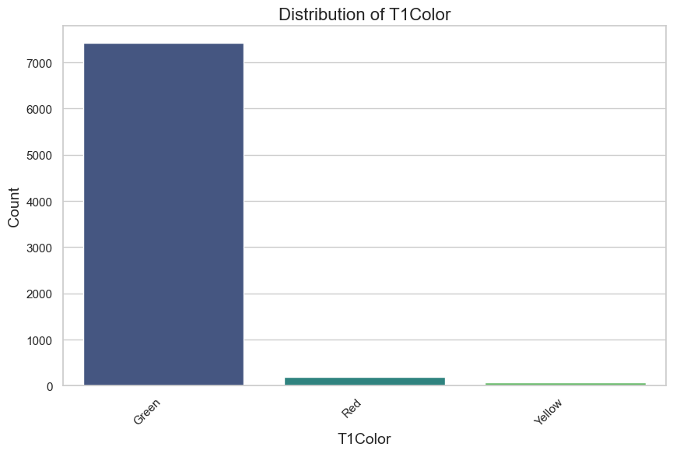
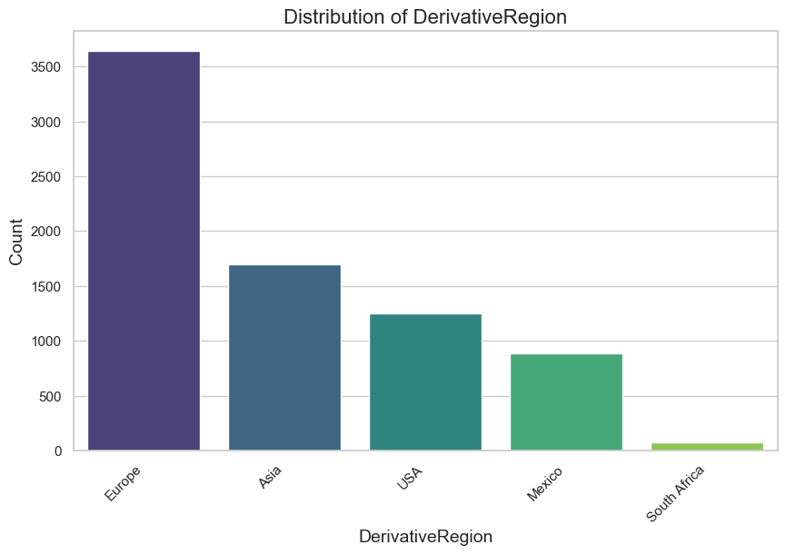
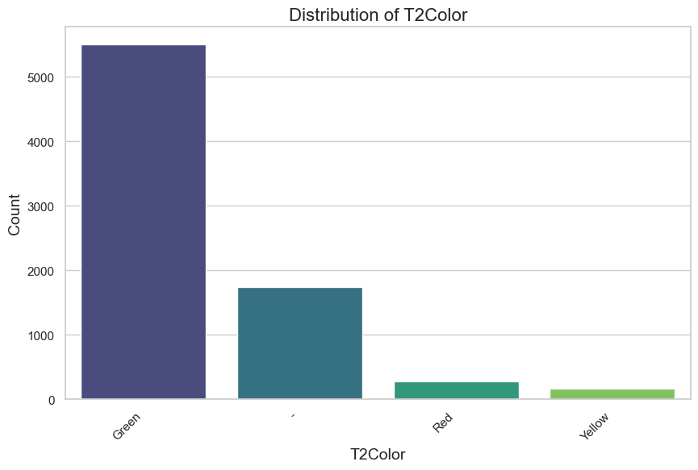
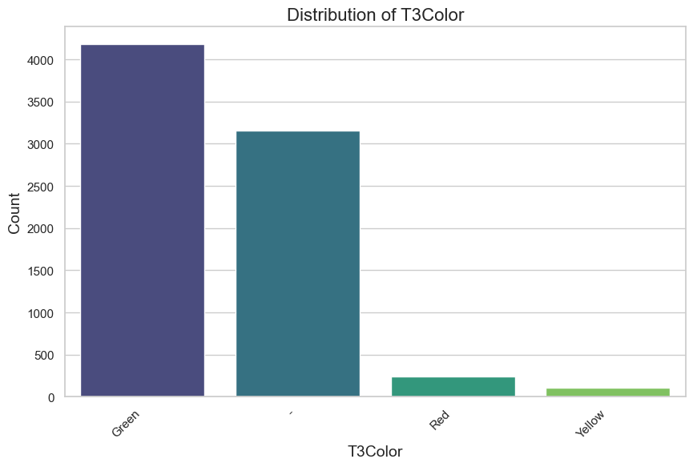
Data Exploration
T1
Audit History – Distributions
Region
Audit Results
T2
T3

Slide 8
Data Exploration
Audit History – Missing values
143 missing values on Derivative Region
Removed missing values observations

Slide 9
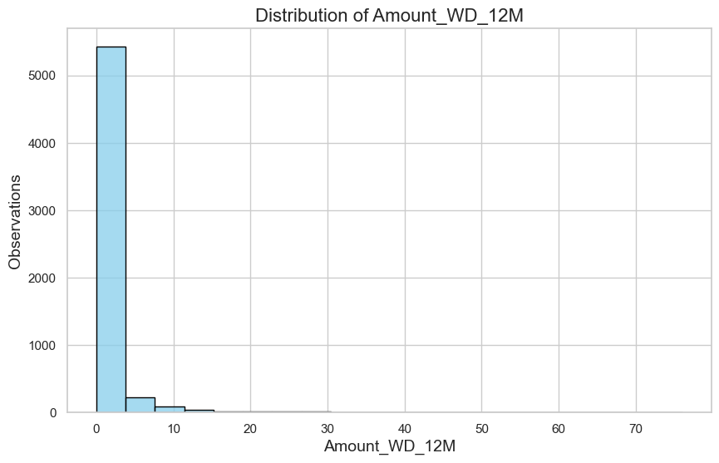
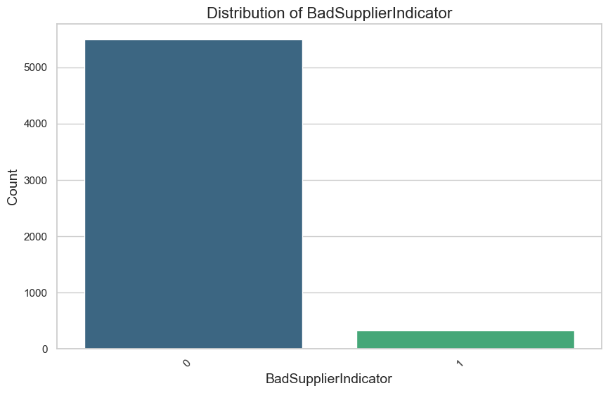
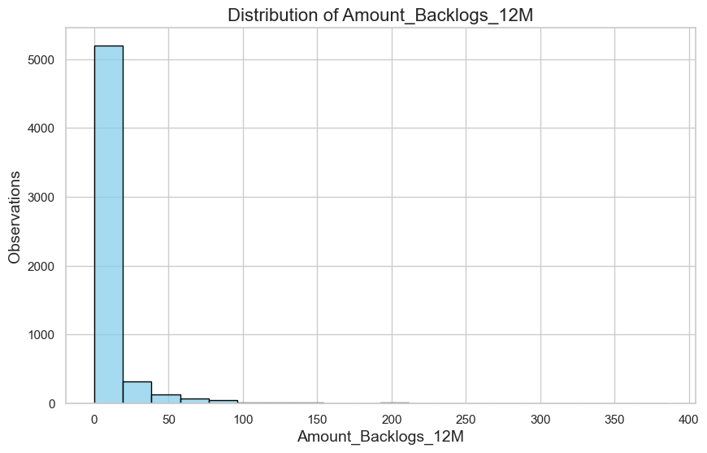
Data Exploration
Supplier Performance – Distributions
Wrong Deliveries (12M)
Bad Supplier Indicator
Backlogs (12M)

Slide 10
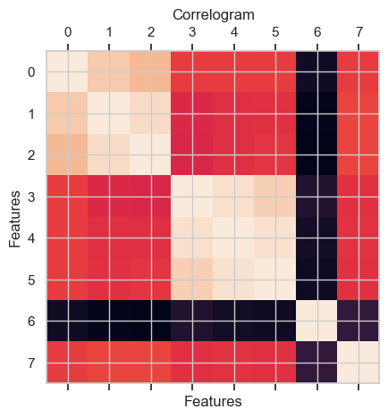
Data Exploration
Supplier Performance – Correlation
Positive correlation between 3, 6, and 12 months of wrong deliveries ~ 0.83
Positive correlation between 3, 6, and 12 months of backlogs ~ 0.94
Negative correlation between the LPKM score and all other features ~ – 0.5

Slide 11
Data Exploration
Supplier Performance – Missing values
Binary coding Bad Supplier Indicator
6 missing values on Supplier LPKM

Slide 12
Data Preprocessing & Feature Engineering
Initial Steps
Remove duplicate date features
Code categorical features numerically

Slide 13
Data Preprocessing & Feature Engineering
Overall approach
Numerous suppliers without audit history or few audit records
Varying number of entries
Predictive model for supplier,derivative pairs that don’t require a full audit history!

Slide 14
Data Preprocessing & Feature Engineering
Feature Selection
Information of suppliers:
LPKM score
Bad Performance Indicator
Information of derivatives:
Derivative region
Production line
Additional information in audit results and Wrong Orders/Backlogs

Slide 15














Data Preprocessing & Feature Engineering
WO and Backlogs in the past 3 months
The two data sets are chronologically linked
The 3, 6 and 12 months ‘prior’ are relative to the latest audit records
$$3 months$$
$$6 months$$
$$9 months$$
$$2022$$
$$Feb$$
$$Mar$$
$$Apr$$
$$May$$
$$Jun$$
$$Jul$$
$$Aug$$
$$Sep$$
$$Oct$$
$$Nov$$

Slide 16
Data Preprocessing & Feature Engineering
Previous audit results
Time elapsed since last audit and the received qualification
First audit observations are discarded

Slide 17
Data Preprocessing & Feature Engineering
Selected features
Derivative Region
Production Line
Latest qualification at each audit stage
Wrong Orders in the past 3 months
Backlogs in the past 3 months
LPKM score
Bad Supplier Indicator

Slide 18
Model Selection & Predictions
This constitutes a multiclass classification problem
I opted to predict each audit stage independently
Three algorithms were assessed and compared:
Random Forest
Logistic Regression
Support Vector Classifier

Slide 19
Model Selection & Predictions
Evaluation metric
Mean accuracy of 5-fold cross-validation
Standard deviation

Slide 20
Model Selection & Predictions
Best model
Hyperparameter tuning
T1
T2
T3
Random Forest
Mean Accuracy: 0.9890
Random Forest
Mean Accuracy: 0.9647
Logistic Regression
Mean Accuracy: 0.9280
Number of estimators, maximum depth, minimum samples per split and leaf
C and penalization

Slide 21
Model Selection & Predictions
Audit results
Simple heuristic for deriving Audit Result
Achieved accuracy of 0.5985
Individual models maintained high predictive capabilities (> 0.92)
T1 Random Forest
T2 Random Forest
T1 Logistic Regression
T1 Prediction
T2 Prediction
T3 Prediction
Latest stage with a different qualification to ‘non-audited’
Audit result prediction

Slide 22
Business Recommendations
Non-competitive results but promising methodology
63.29% of non-red results
Further analysis on results

Slide 23
Model Maintenance
Documentation
Modularity
Validation cycle

Slide 24
Further Development
Additional data exploration
Supplier Clustering
Missing data handling
Engineer additional features
Audit as a sequential process

Slide 25
Thank You!

Slide 26
Extra Slides
Additional data exploration
Missing data handling
Supplier Clustering
Engineer additional features
Audit as a sequential process

